Slide 1
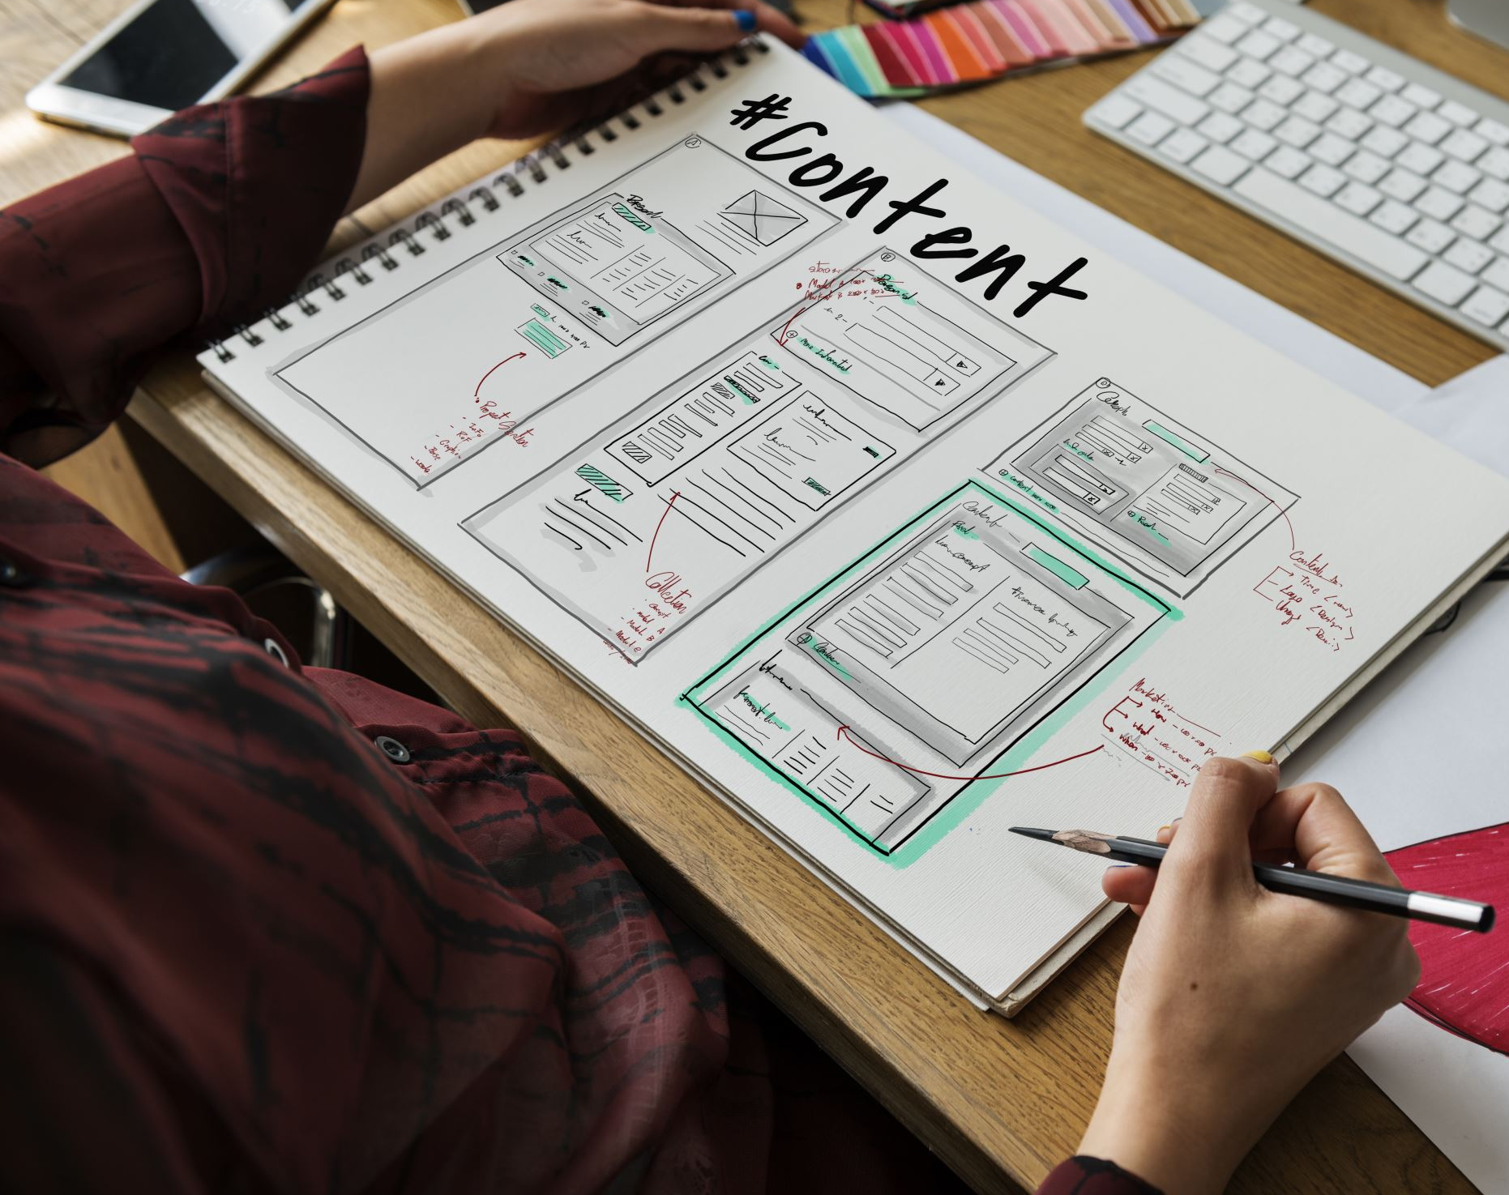
Design UI&UX CSCI5601 Team Orange Topic: Pre-Trip Vacation
Faiza Umatiya (B00899642)
Harsh Kamleshbhai Shah (B00899573)
Hrishi Patel (B00911902)
Karan Singh Rathore (B00902792)
Qiwei Sun (B00780054)

Slide 2
Background
Online flight booking is a complex cognitive task [1]
Tourists become increasingly dependent on mobile city guides to locate tourist services and retrieve information about nearby points of interest when visiting unknown destinations. [2]
Thanks for mobile apps and online platforms, vacation planning has become much easier and accessible.
Design a user-centered mobile trip planning application.
We explored a three applications for vacation planning MakeMyTrip, GoIbibo, Expedia etc.
We modeled our project around MakeMyTrip.

Slide 3
Motivation
It has become easier to plan your vacation online, but has it?
Besides just booking hotels and flights, what else do users look for while pre-planning a vacation?
To explore possible reasons that stops users booking for vacation through mobile applications over other sources.
We wanted to understand how users perceive existing applications.
We wanted to understand users' needs for planning a vacation.
We wanted to comprehend the difficulties travellers confront when making travel plans.

Slide 4
Our Approach
We reviewed several research paper and produced themes for our project.
We produced themes for our project.
We conducted a study for contextual inquiry which had questions and observations tasks covering important features of any travel application.
The tasks included booking a flight, booking hotels, exploring activities and attractions and booking holiday packages.

Slide 5
Study One: Research Goal
Evaluated user needs from the current system in terms of achieving a task.
To know which aspects matter the most for users while booking a flight.
Learn how users discover city attractions and book a reservation.
To understand how users find and book a hotel.
Recognizing features/recommendations that can improve the usability of the application.

Slide 6
Study One: Research Description
We performed contextual inquiry.
Users were asked to perform four tasks.
Tasks and interview questions were asked.
Tasks covered booking flights, hotels, and holiday packages and searching for activities/attractions.
Results were captured in coding sheets.
Formed themes from Affinity Diagraming.

Slide 7
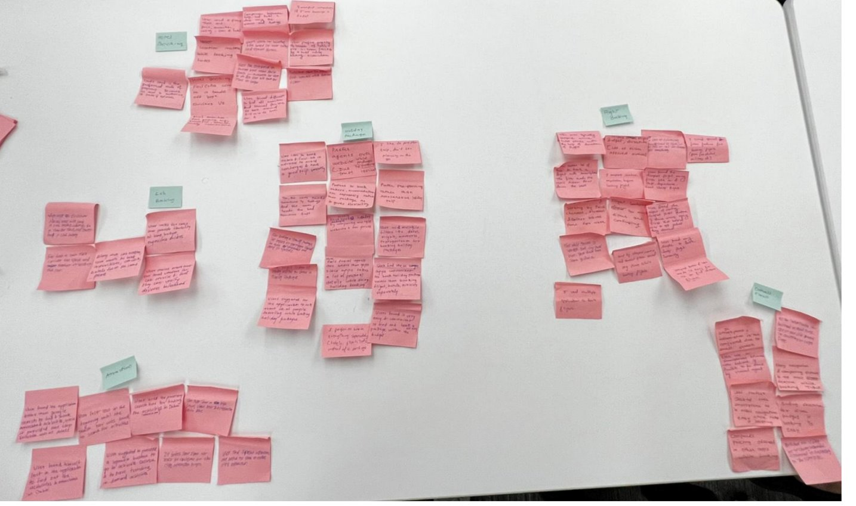
Affinity Diagraming
Three rounds for affinity diagraming.
Six themes were found after affinity diagraming.
Three themes were selected – booking and searching flights, holiday package and attractions.
Prototypes were created for tasks based on the three themes we finalized from affinity diagraming.

Slide 8
Study One: Results
User should be able to customize the holiday package by customizing the days, hotel stays etc.
While booking flight, “Arrive by” and “Depart at” time selection would give more flexibility to user.
The application can have options for date that will assist users in looking up activities available on that day.
In hotel comparison, the application should have a way of comparing two hotels.

Slide 9
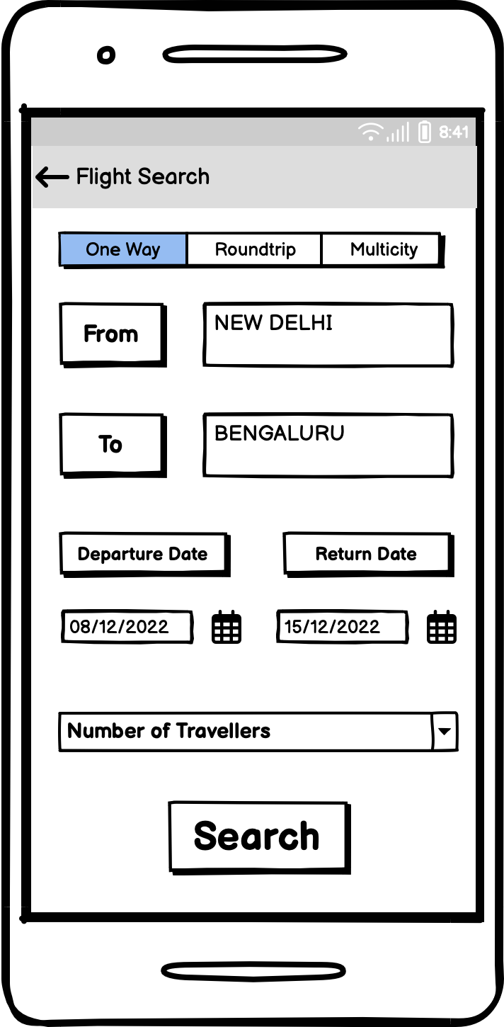
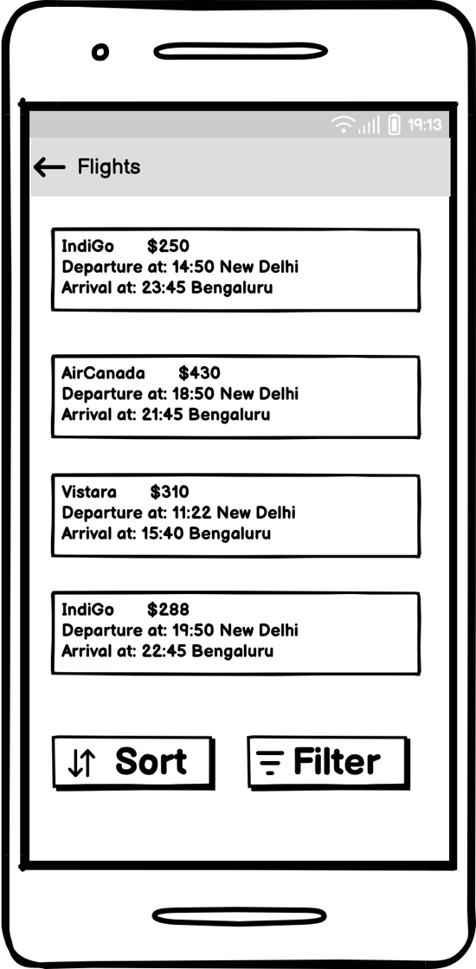
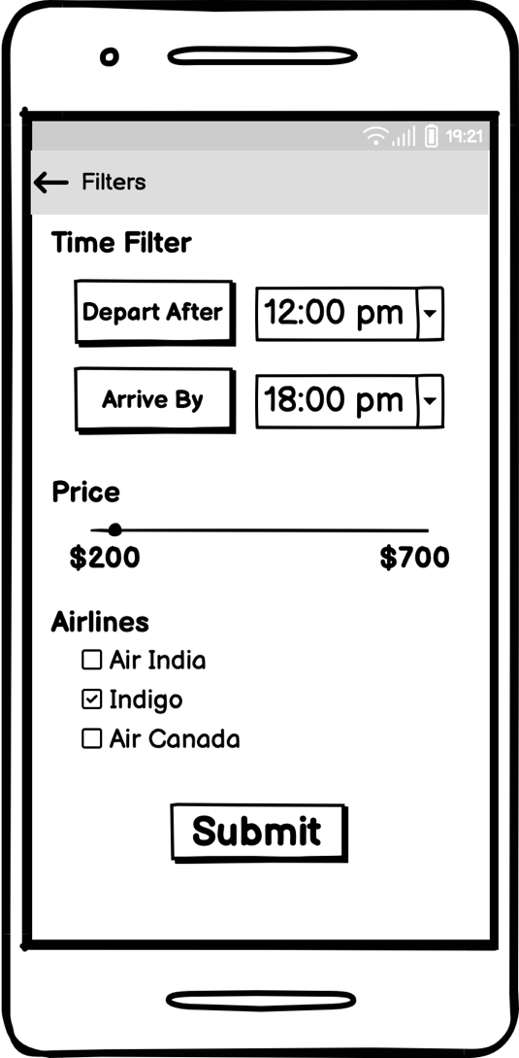
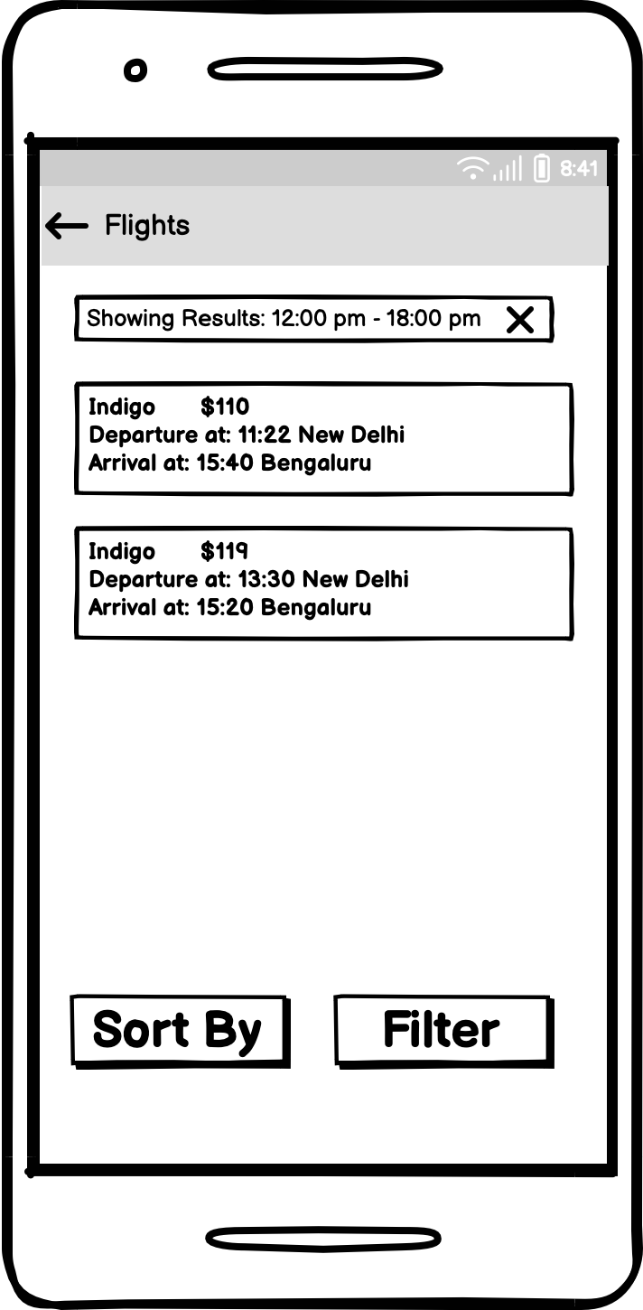
Prototyping – Task 1 (Filtering Flights)

Slide 10
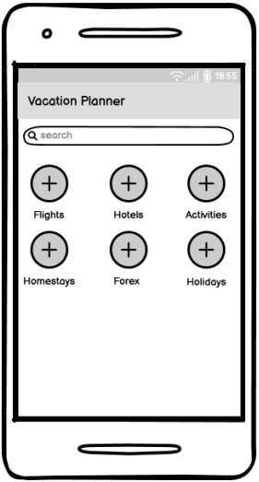
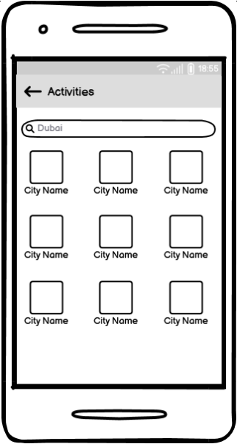
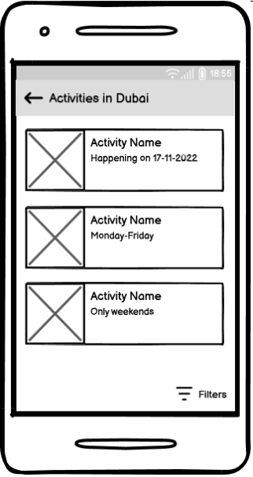
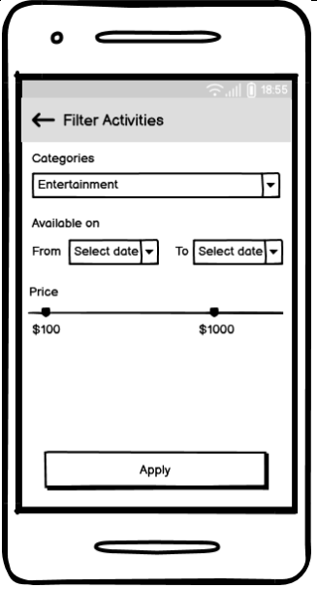
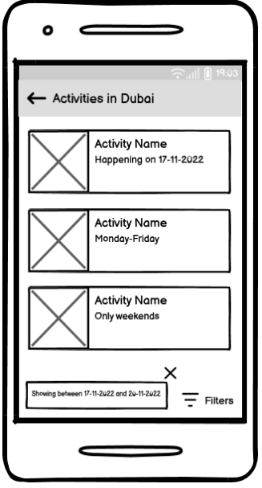
Prototyping – Task 2 (Finding activities)

Slide 11
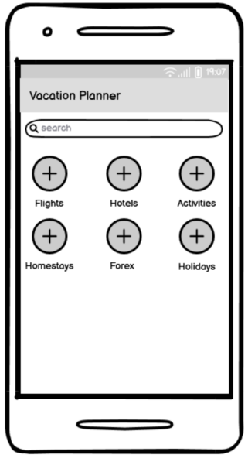
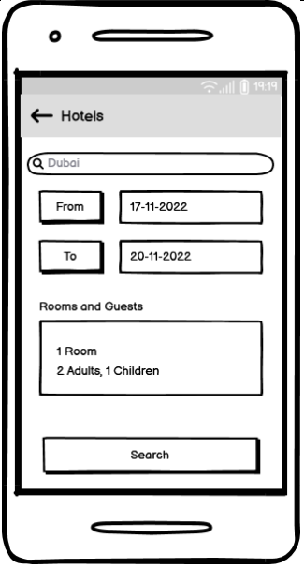
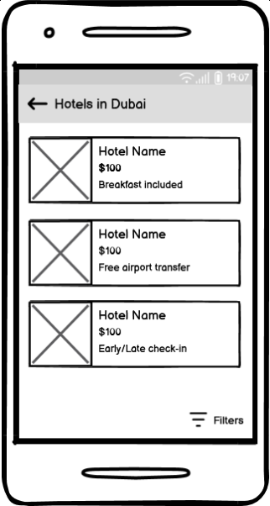
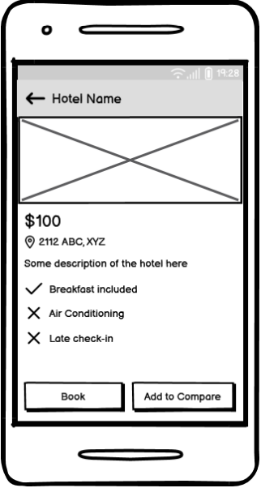
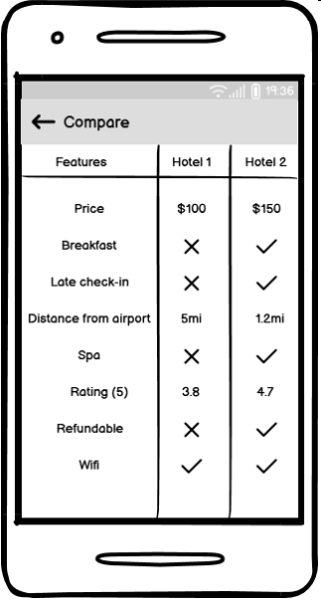
Prototyping – Task 3 (Comparing hotels)

Slide 12
Cognitive Walkthrough
To evaluate our low-fi prototype we went through a cognitive walkthrough as we don’t have real users.
Prototypes were used for the cognitive walkthrough process.
We made experts examine the prototypes’ usability by guiding them through user persona, task scenarios and use-cases.
We identified design issues from the results of the Cognitive Walkthrough.

Slide 13
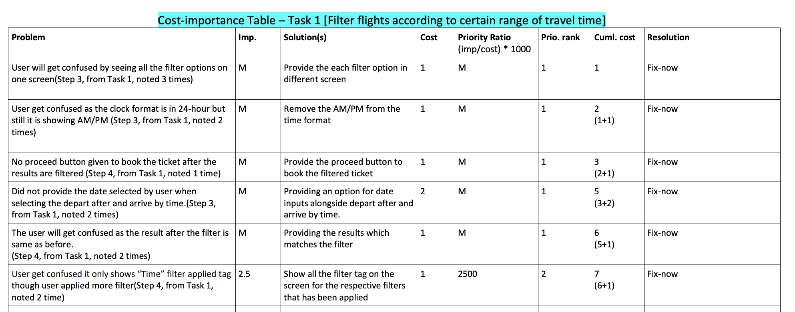
Cognitive Walkthrough: Results

Slide 14
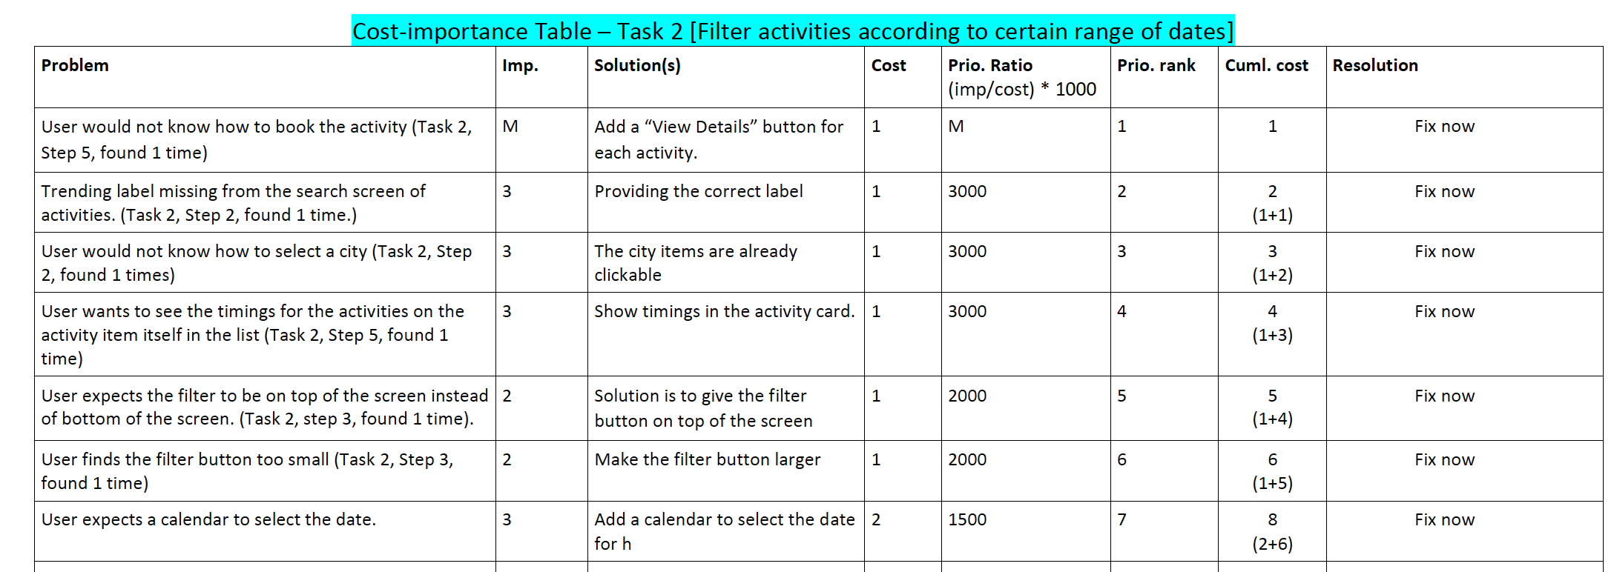
Cognitive Walkthrough: Results

Slide 15
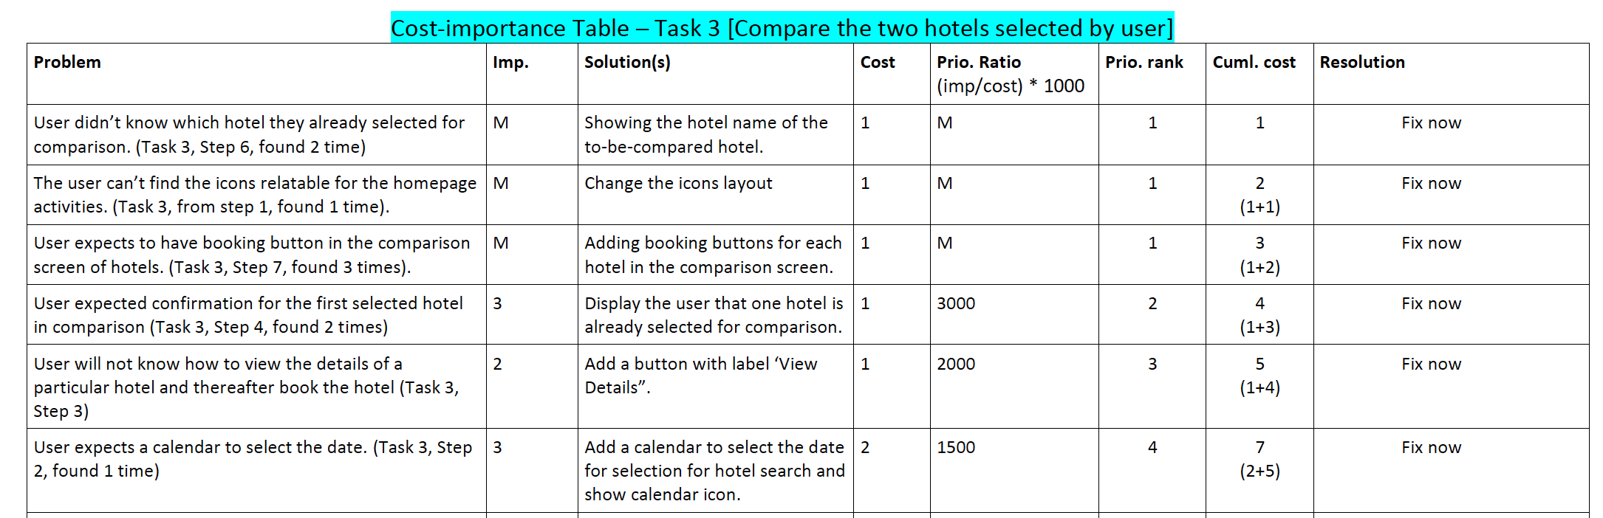
Cognitive Walkthrough: Results

Slide 16
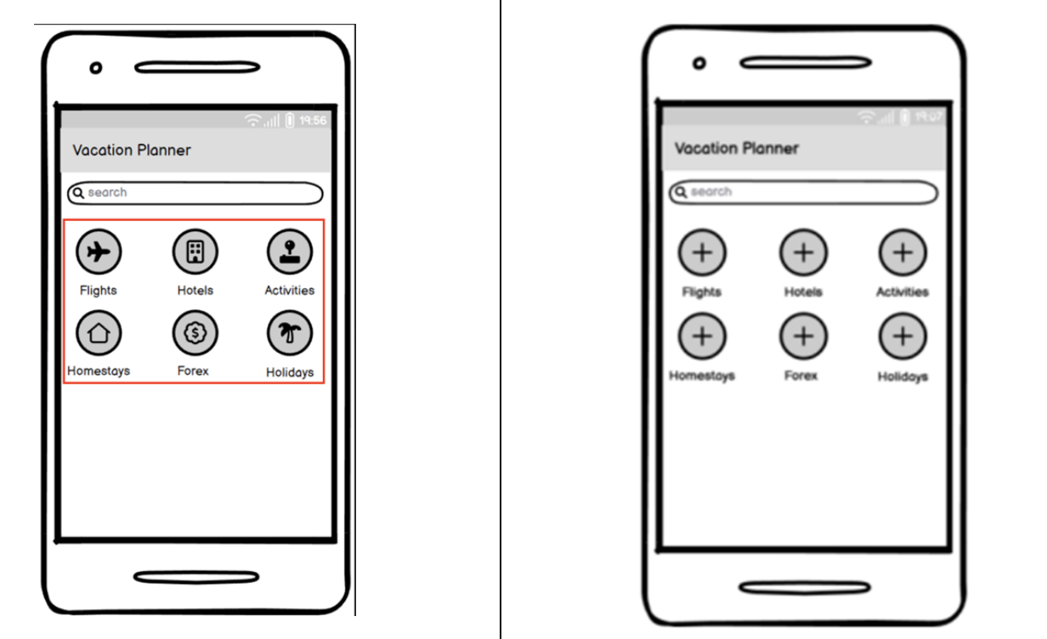
Design Fixes

Slide 17
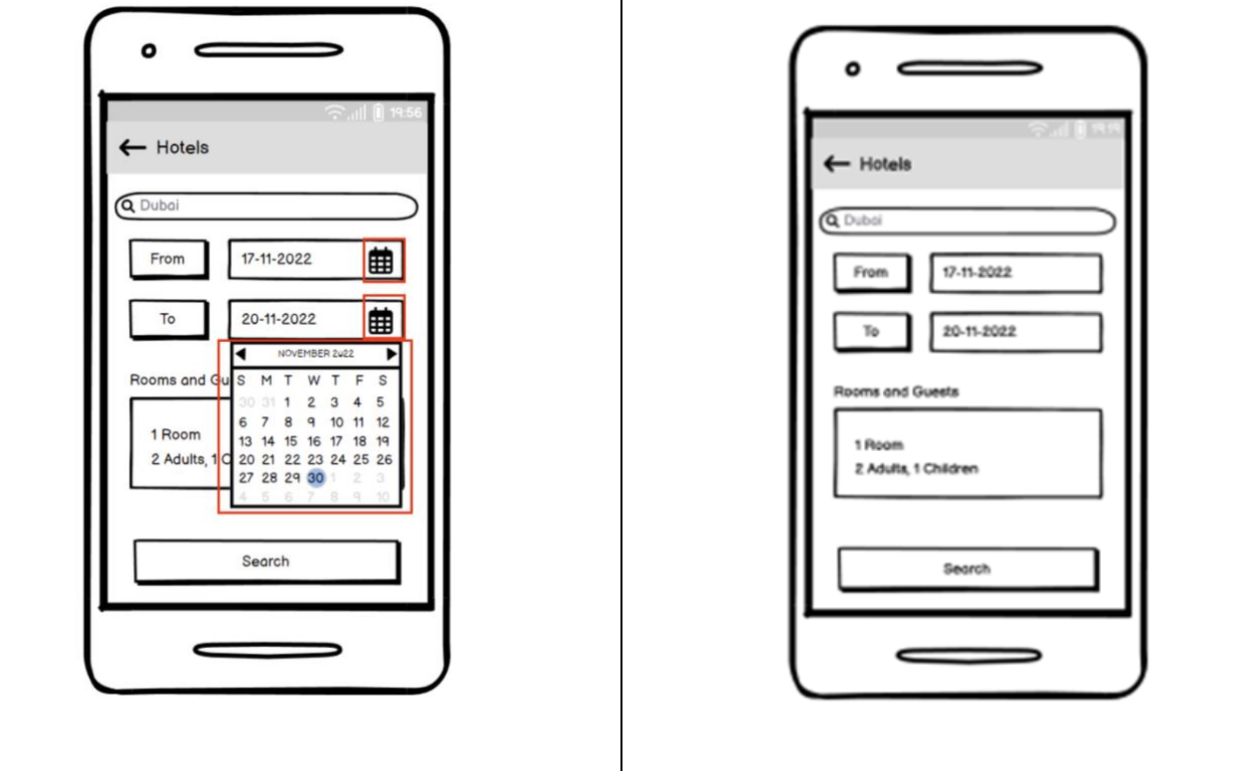
Design Fixes

Slide 18
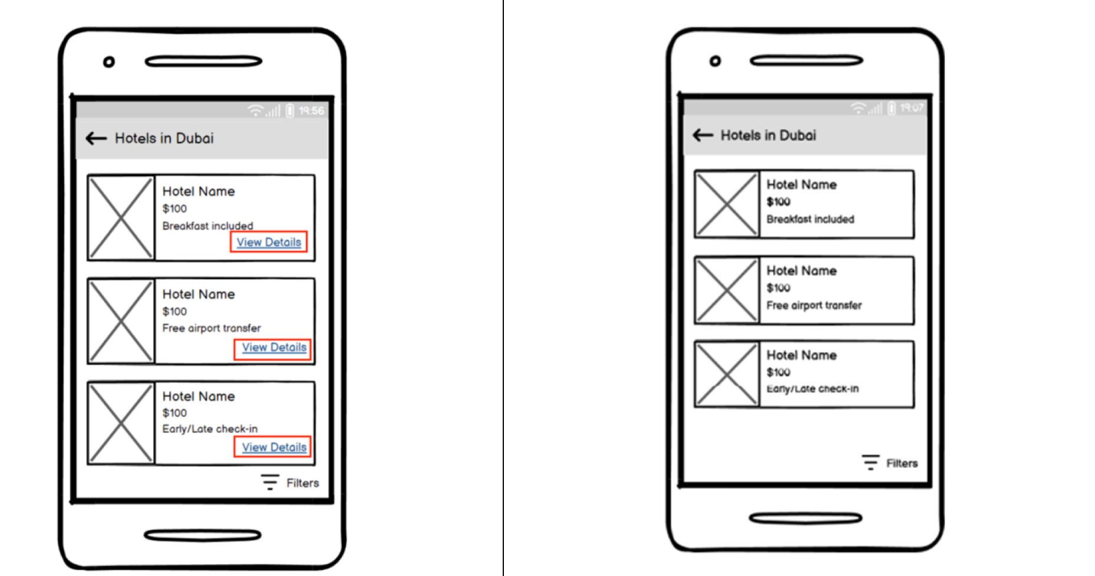
Design Fixes

Slide 19
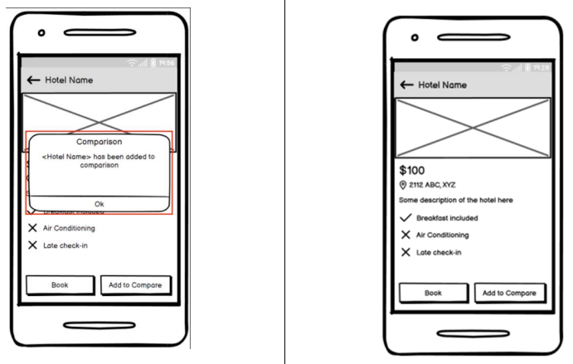
Design Fixes

Slide 20
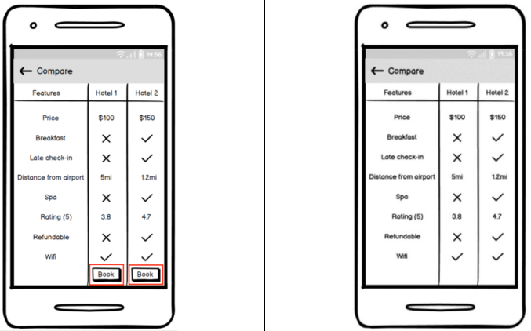
Design Fixes

Slide 21
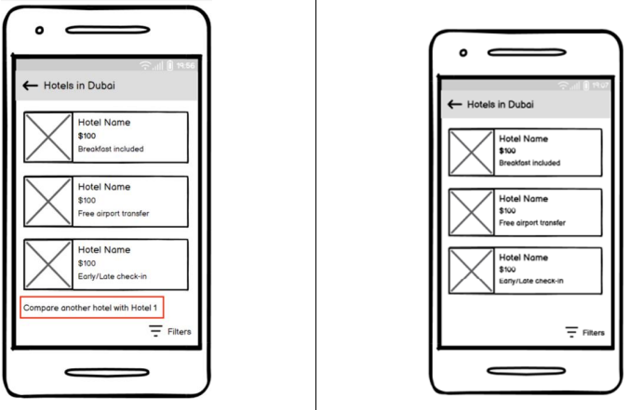
Design Fixes

Slide 22
Findings
Users preferred ease-of-use than an attractive UI.
Users wanted more flexibility while planning their vacation.
Other than basic features like flight, hotel booking, users wanted to have other features like activity bookings, cab bookings, etc.
Users found the new features helpful and interesting.

Slide 23
Reference
[1] Ivan Burmistrov. 2009. Mobile air ticket booking. In European Conference on Cognitive Ergonomics: Designing beyond the Product --- Understanding Activity and User Experience in Ubiquitous Environments (ECCE '09). VTT Technical Research Centre of Finland, FI-02044 VTT, FIN, Article 11, 1–5.
[2] Damianos Gavalas, Vlasios Kasapakis, Charalampos Konstantopoulos, Grammati Pantziou, Nikolaos Vathis, and Christos Zaroliagis. 2014. A personalized multimodal tourist tour planner. In Proceedings of the 13th International Conference on Mobile and Ubiquitous Multimedia (MUM '14). Association for Computing Machinery, New York, NY, USA, 73–80. https://doi.org/10.1145/2677972.2677977
[3] “Balsamiq cloud,” Balsamiq.cloud. [Online]. Available: https://balsamiq.cloud/. [Accessed: 03-Dec-2022].
[4] “MakeMyTrip,” MakeMyTrip.com. [Online]. Available: https://www.makemytrip.com/. [Accessed: 04-Dec-2022].
[5] “Goibibo - best travel website.” Goibibo. [Online]. Available: https://www.goibibo.com/. [Accessed: 05-Dec-2022].
[6] “Expedia” Expedia.ca. [Online]. Available: https://www.expedia.ca/. [Accessed: 05-Dec-2022].

